Slide 1
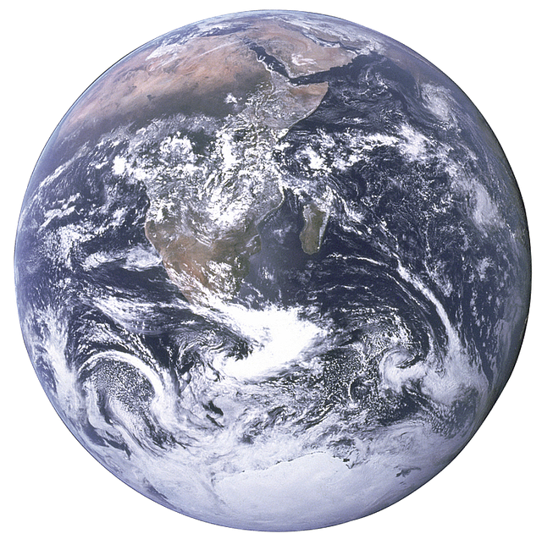
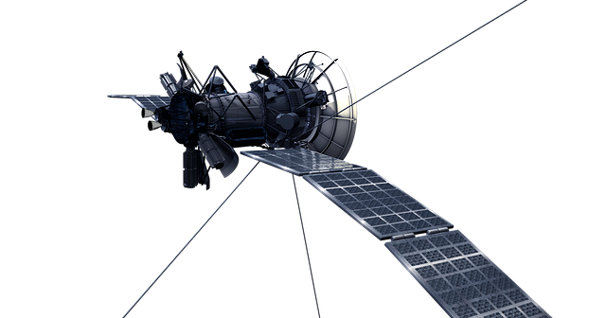
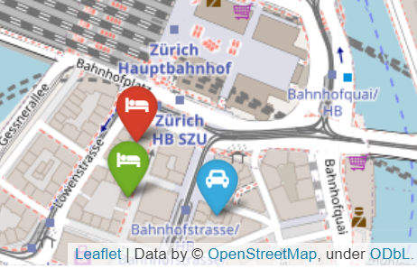
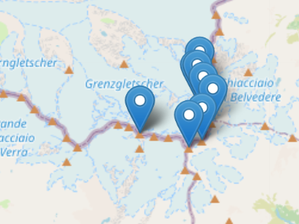
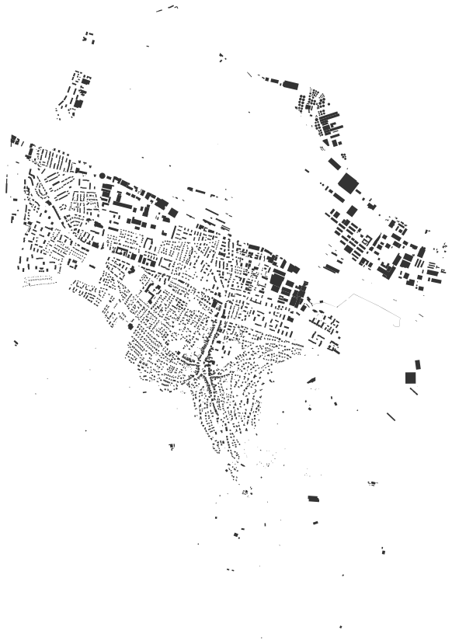
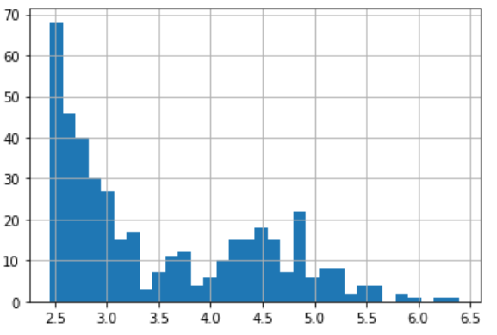
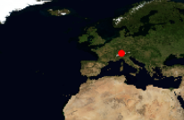
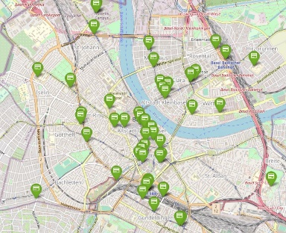

Geospatial Analysis for the Smart City Big Data BBQ 9/24/2021
Prof. Martin Christen FHNW – University of Applied Sciences and Arts Northwestern Switzerland School of Architecture, Civil Engineering and Geomatics Institute Geomatics martin.christen@fhnw.ch
@MartinChristen
Notes:
16:20 – 16:35

Slide 2


What is Geospatial Data ?
Geospatial data is data with a spatial component - it describes objects with a spatial reference to the earth’s surface.
This data consists of a spatial component (where), attributes (what), and often a time reference (when).

Slide 3
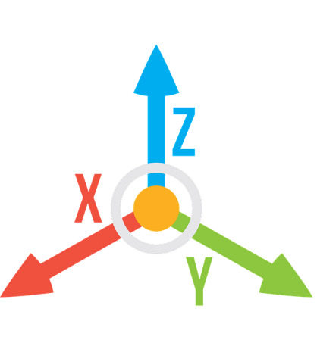


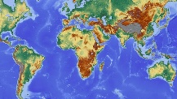
What is geospatial data?
Geospatial data is multidimensional, we need at least two coordinates to define a position (for example x and y).
Geospatial data can be huge - some datasets may be in the terabyte to petabyte range, which also makes it really hard to display it or to update it.
And when we want to view the data it is usually projected to a flat surface.

Slide 4

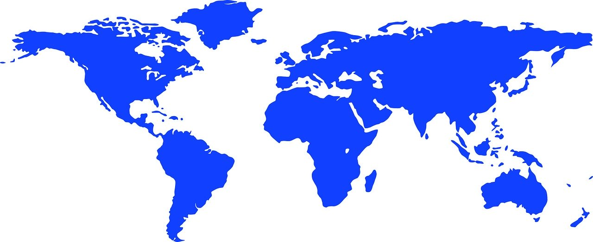
Geospatial Data Representation
There are two main methods of representing geospatial data digitally. Both methods try to reduce the reality of something we can store on the computer, the first kind is called raster data and the second vector data.
raster data
vector data

Slide 5
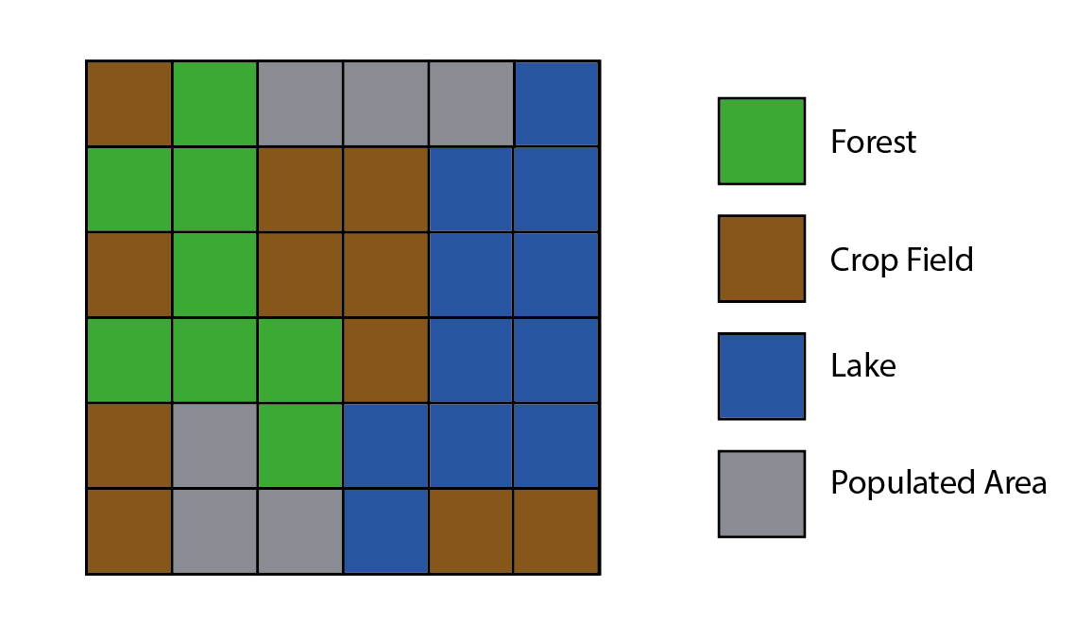
Raster Representation
In a raster representation, space is divided into square cells. Each cell then receives properties or attributes to this cells.
Often this raster data comes from remote-sensing satellites.
Working with this gridded representation is often quite easy.
Formats:
.jpg
.png
.tiff (Geotiff)

Slide 6
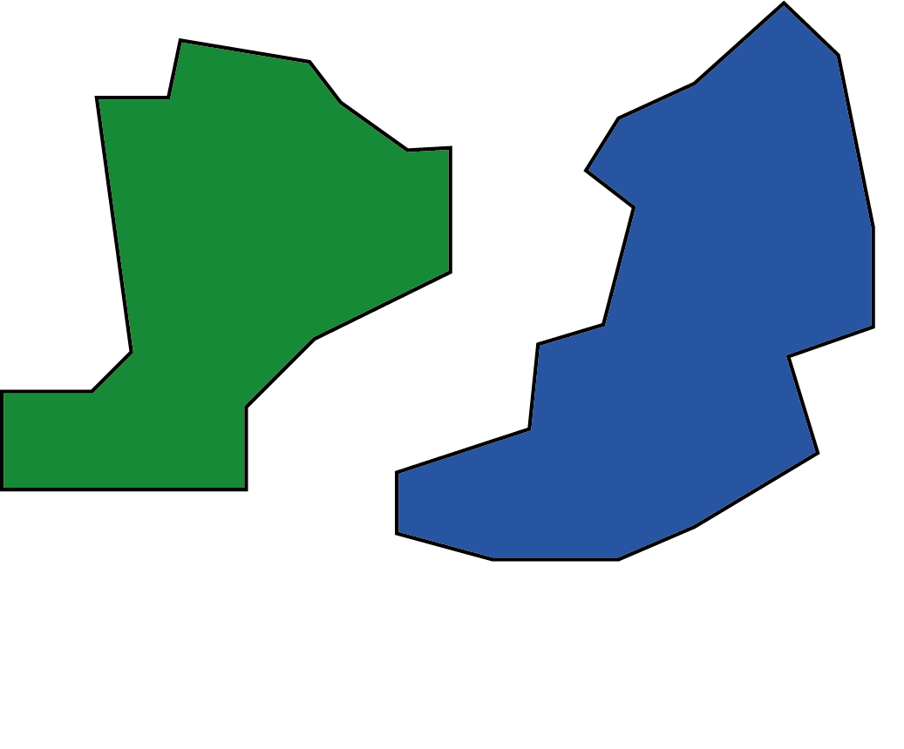
Vector Representation
In a vector representation, we would have points captured around the lake and connect them. For the lake in the previous raster example, we would have a polygon instead of grids. Vector data contains points, lines, polygons and more.
Formats:
Shapefile
GeoJSON
GeoPackage
...

Slide 7


Where to get data ?
Nowadays there are many global and local open (and closed) data portals, geospatial data is present everywhere.
https://index.okfn.org/dataset/
https://data.world/datasets/open-data
https://www.gis-mannheim.de/ (GeoPortal der Stadt Mannheim)
https://www.swisstopo.admin.ch/de/geodata.html (Switzerland)

Slide 8
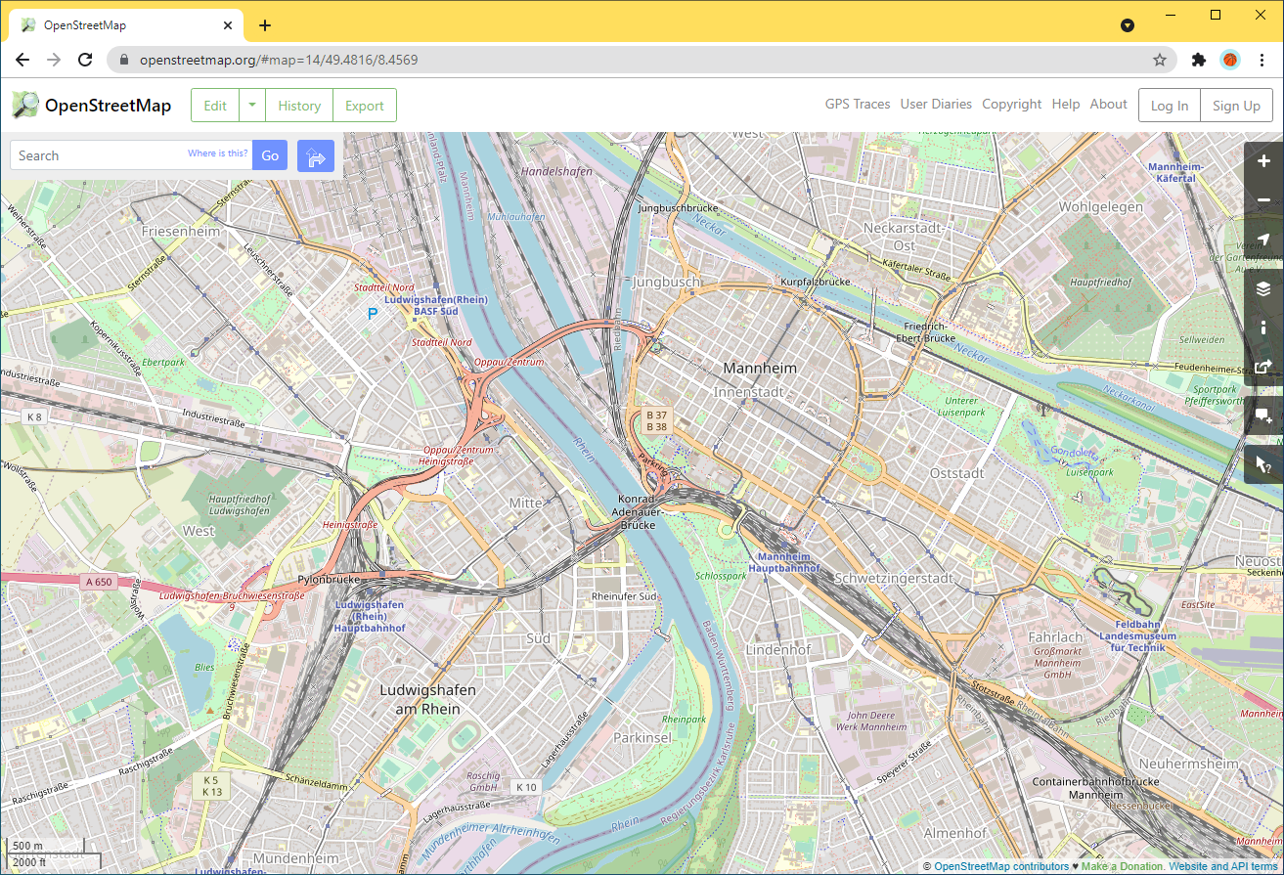
OpenStreetMap
OpenStreetMap (OSM) is a collaborative project to create a free editable geographic database of the world.

Slide 9



OpenStreetMap & Python
OSMnx Python for Street networks
A Python module to retrieve, model, analyze and visualize street networks and other geospatial data from OpenStreetMap
https://github.com/gboeing/osmnx
https://osmnx.readthedocs.io/en/stable/
Installation:
conda install osmnx folium -c conda-forge

Slide 10
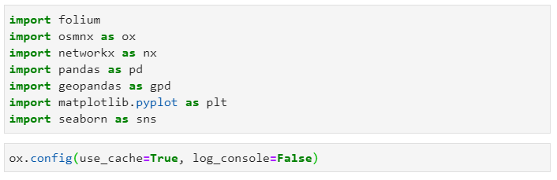
Initialize – Always use caching

Slide 11
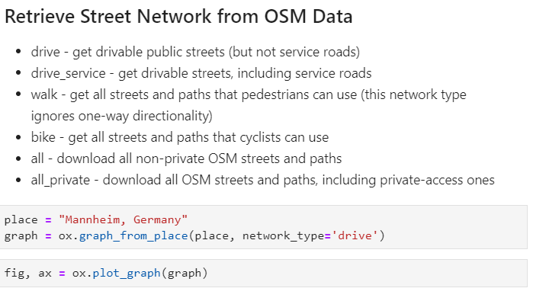

Slide 12
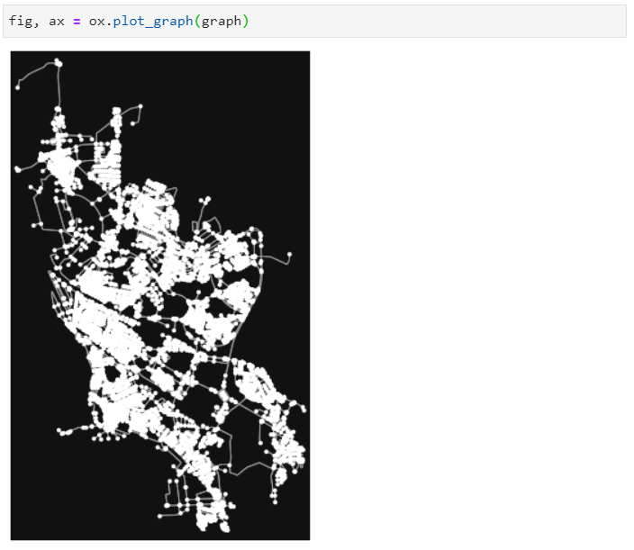

Slide 13
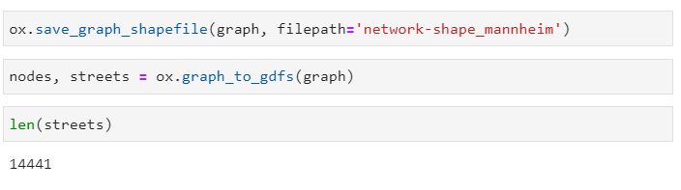
Export and retrieve some info

Slide 14
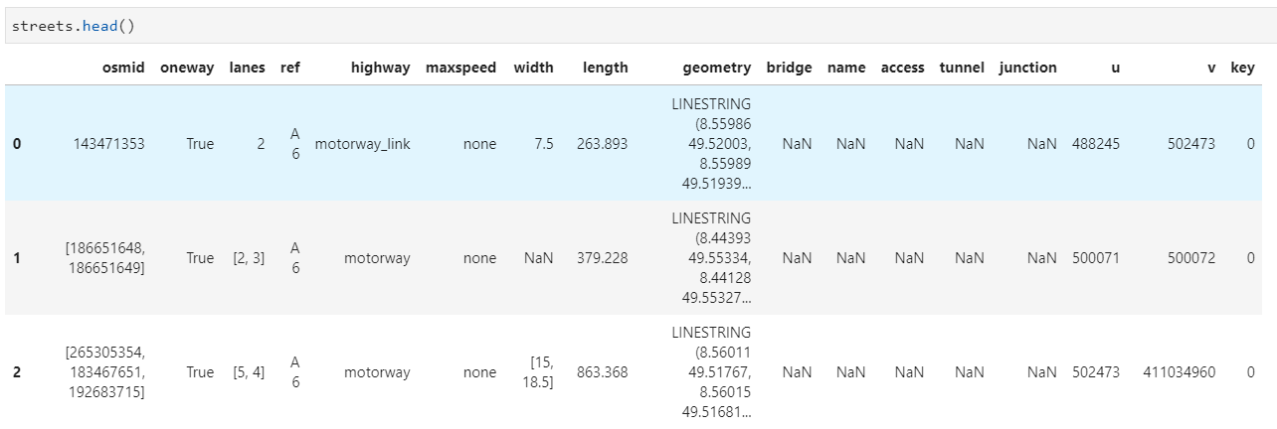
GeoPandas DataFrame

Slide 15
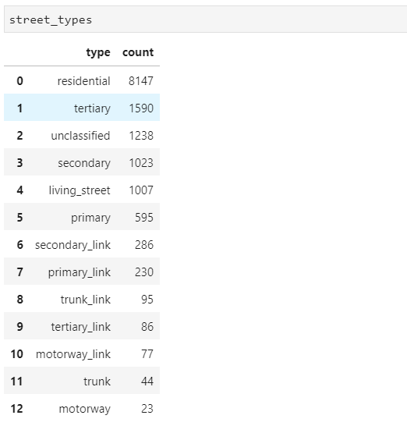
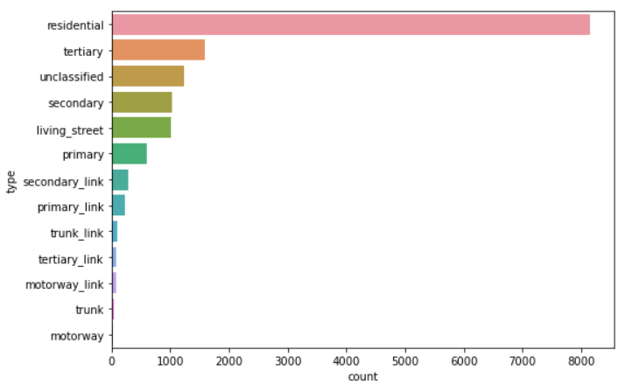
Street Types in Mannheim / OSM

Slide 16
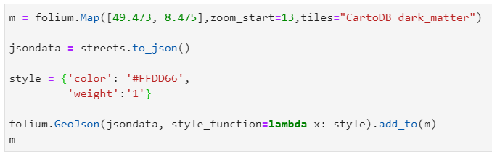
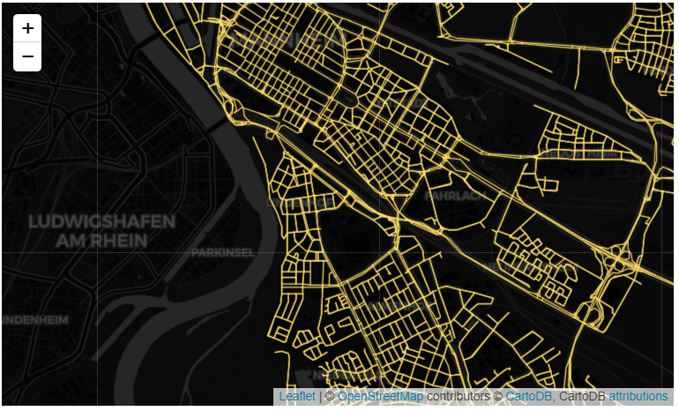
Display Street Network on a Map using Folium

Slide 17
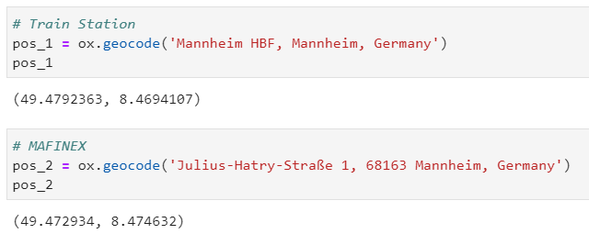
Geocoding

Slide 18
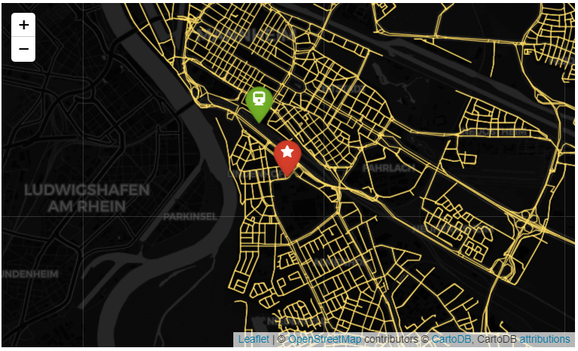

Slide 19
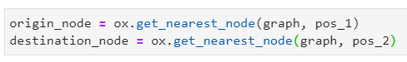
Routing
Get the nearest node in the graph (street network)
Then find the route (shortest path):

Slide 20
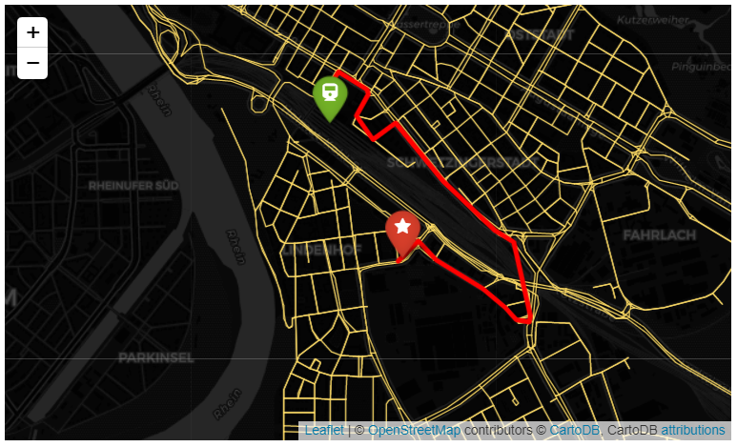
Result (Connected Nodes)

Slide 21
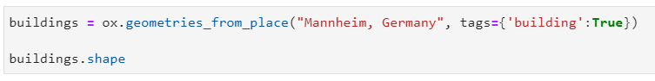
Retrieving Building Footprints
This download takes a while. Result: around 68000 geometries

Slide 22
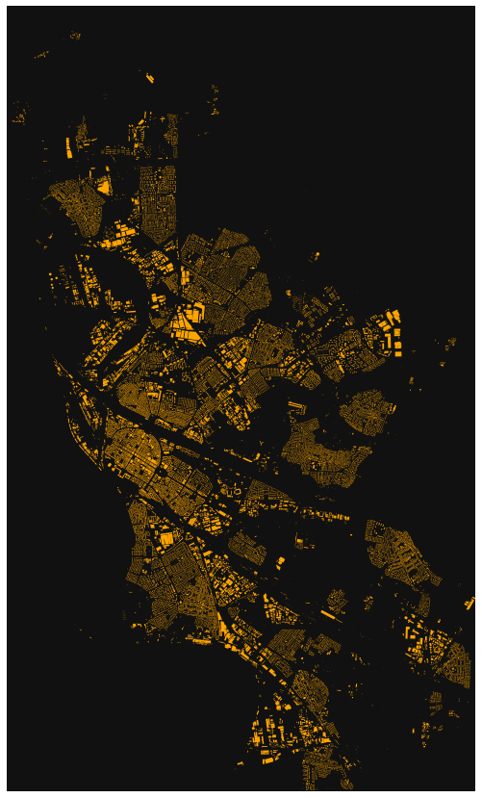

Slide 23
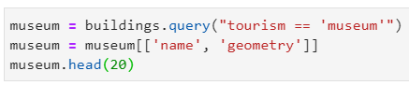
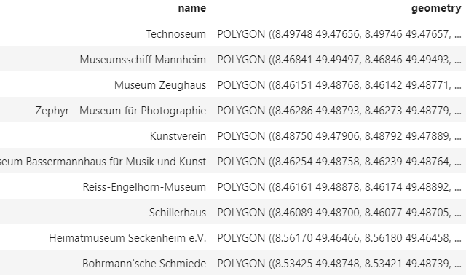
Query specific building footprints

Slide 24
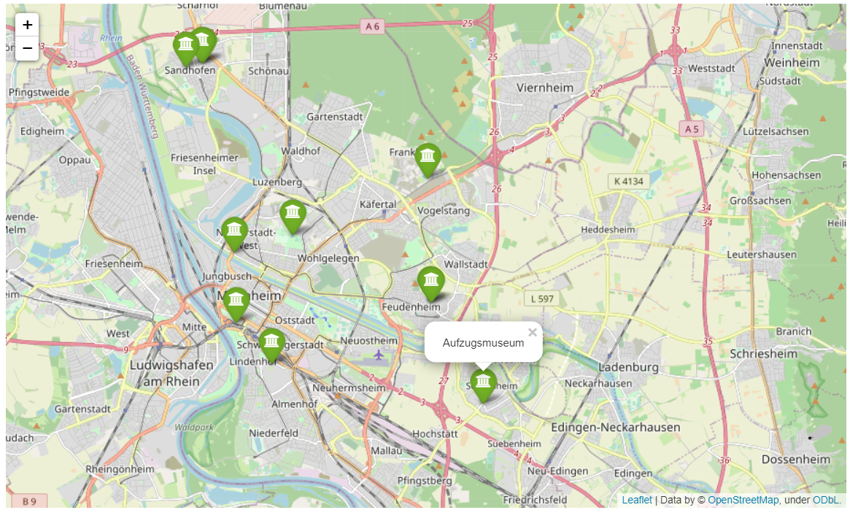
If you want locations: pois_from_place

Slide 25

Thanks
Link to the Notebook:
https://github.com/martinchristen/bigdatabbq2021

